Slide 1

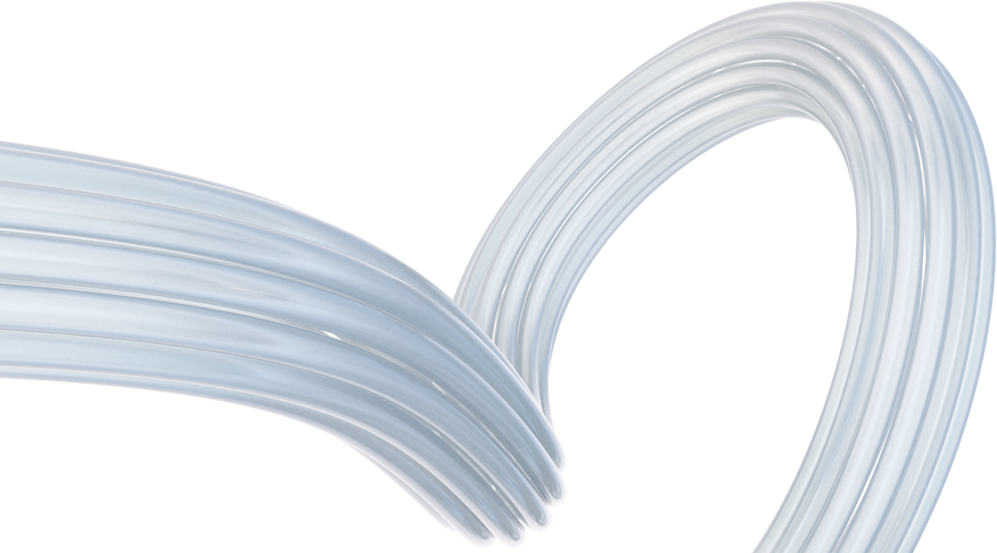
AURA –
An AUTONOMOUS DEVICE HEALTH & SUPPORT ECOSYSTEM
BY TEAM CODEGALAXY – VIT VELLORE
• Haani Behzad Kuniyil (22MIC0179)
• Sujal Ravindra Dixit (22MIC0115)
• Keerthana Krishnan T (22MID0038)
• Drisanth M (22MIC0139)
• Darsh Marothi (22MID0333)

Slide 2
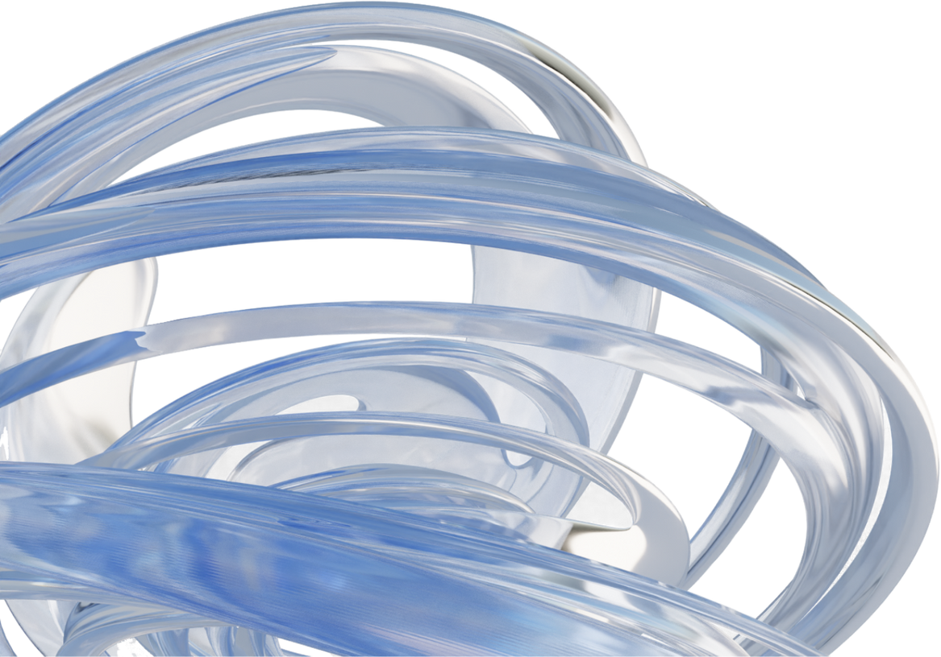
PROBLEM STATEMENT
The current approach to device maintenance is fundamentally reactive, forcing users to contend with unexpected breakdowns and complex troubleshooting without predictive support. This model results in significant user inconvenience, operational downtime, higher repair costs, and a shortened device lifespan.
Users face unexpected device breakdowns leading to inconvenience and downtime.
Manual troubleshooting often requires technical knowledge or service center visits.
Lack of proactive maintenance results in higher repair costs and shorter device lifespan.
Current device support systems are reactive, not predictive.

Slide 3

OVERVIEW
•Aura is an always-on device health companion that monitors all devices — smartphones, TVs, appliances, and wearables — using multimodal AI.
- Predicts failures
- Performs remote fixes
- Coordinates service without human intervention
Powered by a multi-agent system for Diagnostics, Predictive Maintenance, Customer Interaction, Service Coordination, and System Optimization

Slide 4
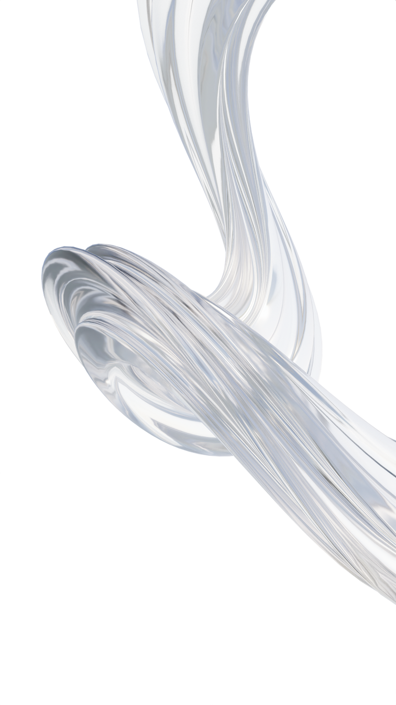
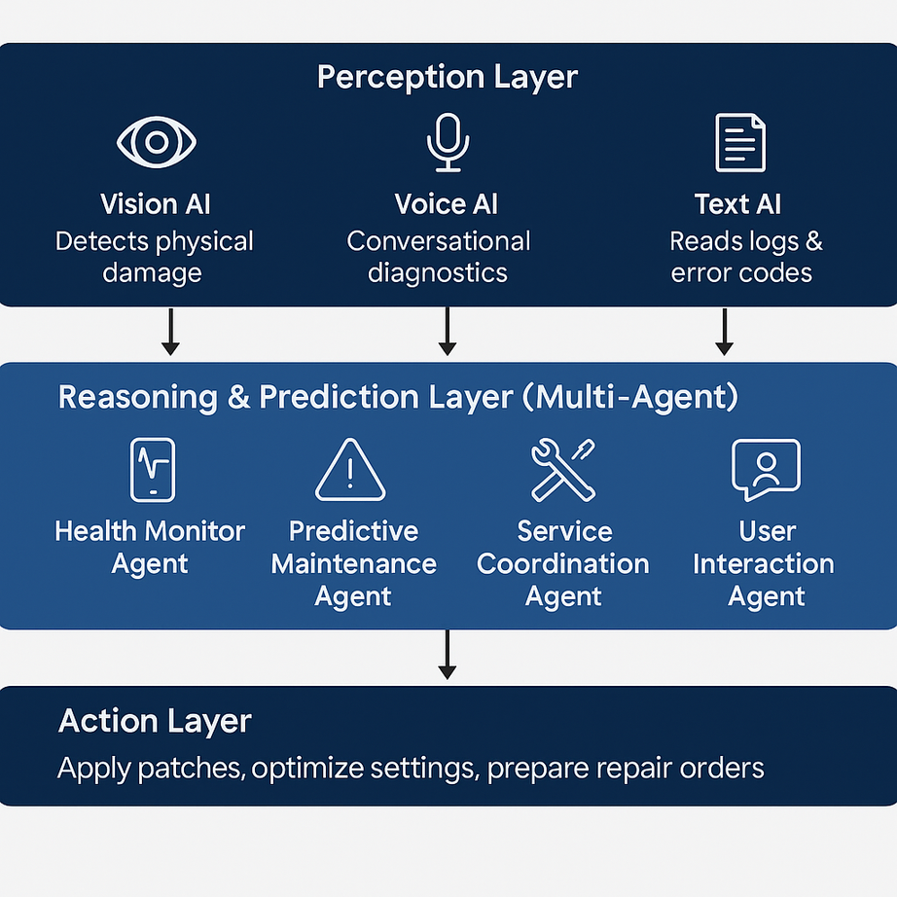
PROJECT OBJECTIVE
Build an always-on health companion for Samsung devices.
Provide proactive diagnostics, predictive maintenance, and automated fixes.
Seamless user experience with minimal human intervention.

Slide 5

KEY FEATURES OF AURA
Multimodal AI for diagnostics and predictions.
Remote self-healing & automated service coordination.
Visual & audio input for troubleshooting.
Real-time monitoring dashboard.
Report generation for insights.

Slide 6
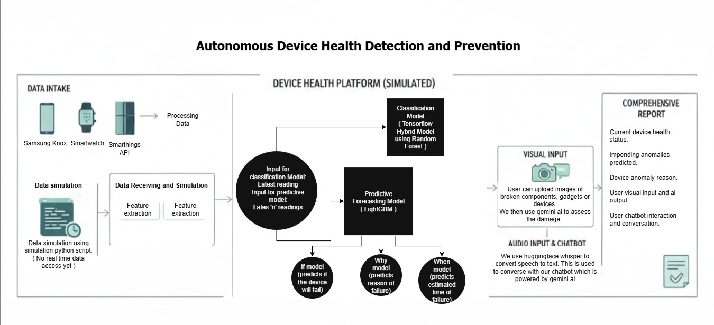
ARCHITECTURAL DIAGRAM

Slide 7
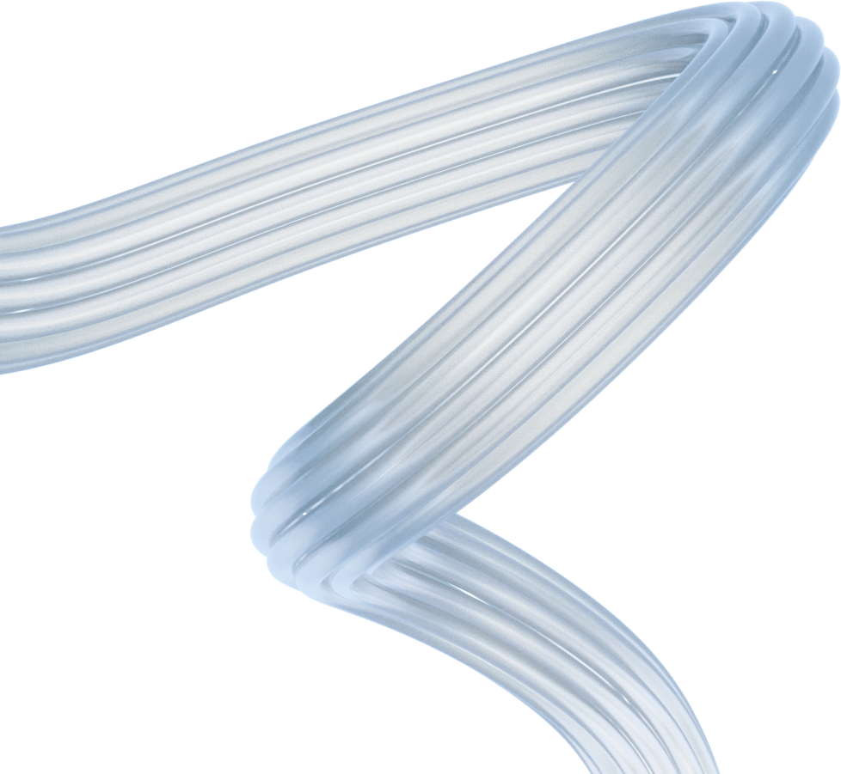
MULTI-AGENT AI SYSTEM
Diagnostics Agent – Detects issues.
Predictive Maintenance Agent – Forecasts failures.
Customer Interaction Agent – Voice & chat support.
Service Coordination Agent – Links with support teams.
System Optimization Agent – Improves performance.

Slide 8
DASHBOARD OVERVIEW
User entry point.
Device selection.
Fault simulation options (CPU / Battery).
Classification model (status + recommended fix).
Predictive model .
Live health graph (real-time status).

Slide 9

ADDITIONAL FEATURES
Visual Input: Upload broken device/component image → AI suggests fix.
Audio Input: Voice chat with AI bot → real-time recommendations.
Reports: Summarized diagnostics, downloadable PDF.

Slide 10
STAKEHOLDERS
Electronics Manufacturers
Customers using smart devices (smartphones, TVs, appliances, wearables)
Service & Support Teams
AI Researchers & Developers
Third-party Service Providers

Slide 11
RESULTS
•- Successful simulation of device faults (CPU & Battery)
•- AI-based diagnostics and predictive analysis
•- Real-time health monitoring
•- Report generation with summarized insights
•- Enhanced customer support automation

Slide 12
FUTURE WORK
•Expand to support more device types and failure modes
• Enable real-time data integration
• Improve predictive accuracy using larger datasets
• Integrate with Samsung’s global service network
• Enhance multimodal AI for better diagnostics

Slide 13
THANK YOU

